Slide 1
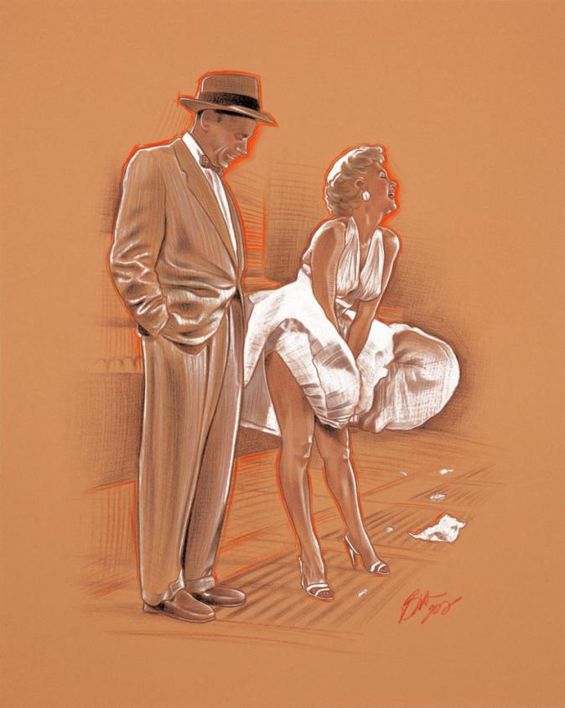
OBRAS DE
ARTE

Slide 2
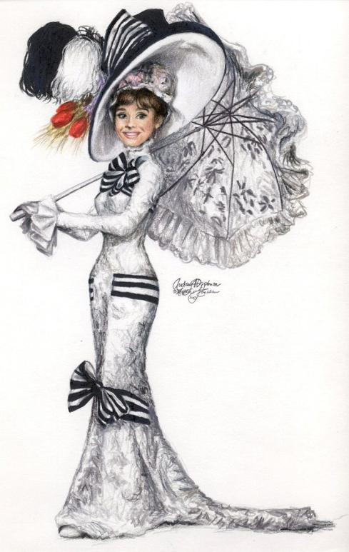
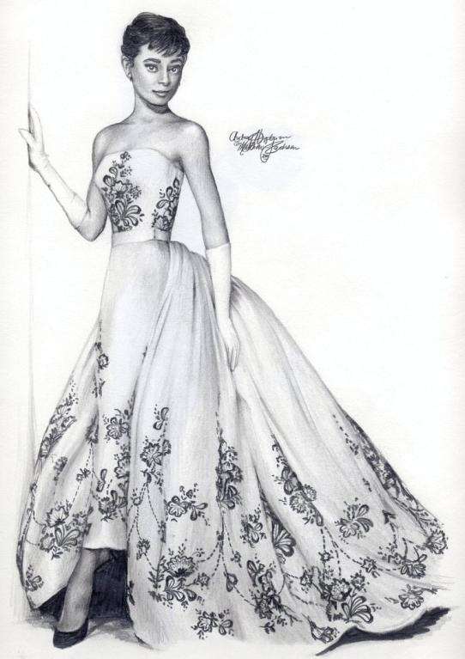
AUDREY
HEPBURN

Slide 3
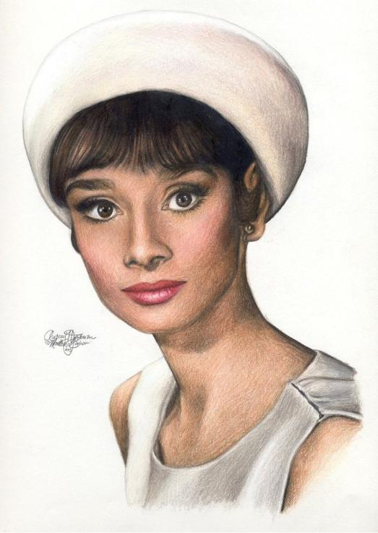
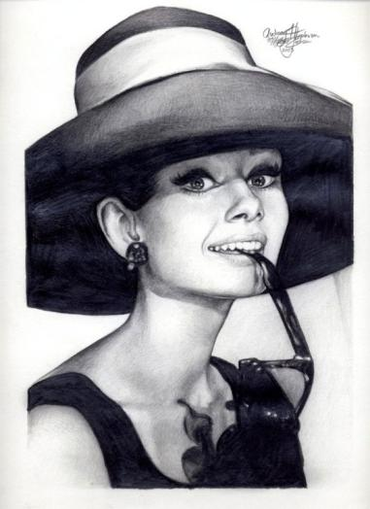
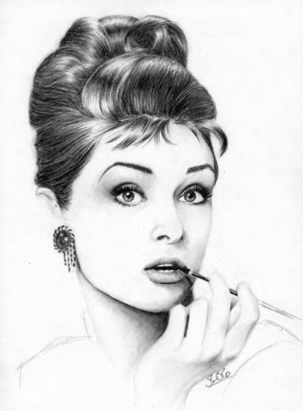
AUDREY HEPBURN

Slide 4
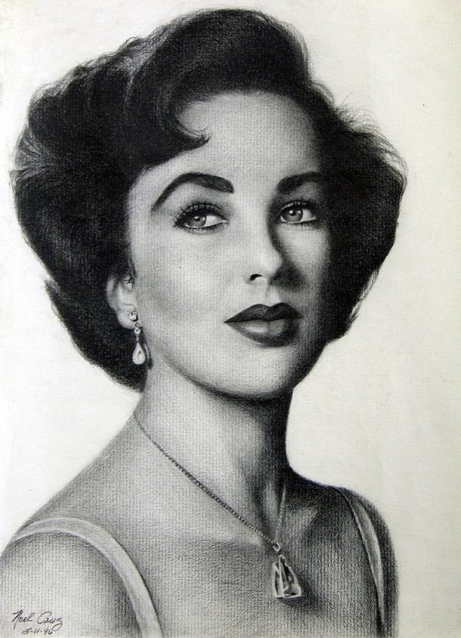
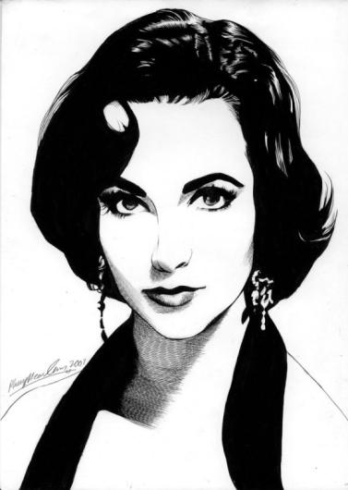
ELIZABETH TAYLOR

Slide 5
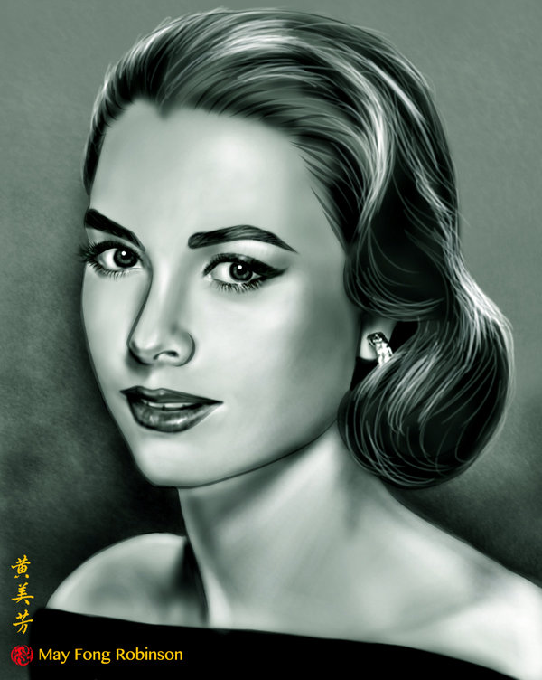
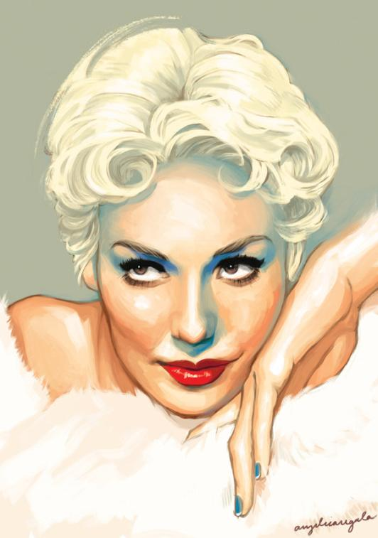
KIM NOVAK
GRACE KELLY

Slide 6
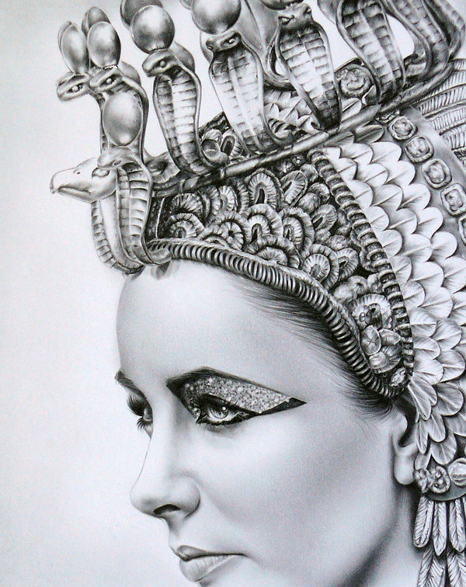
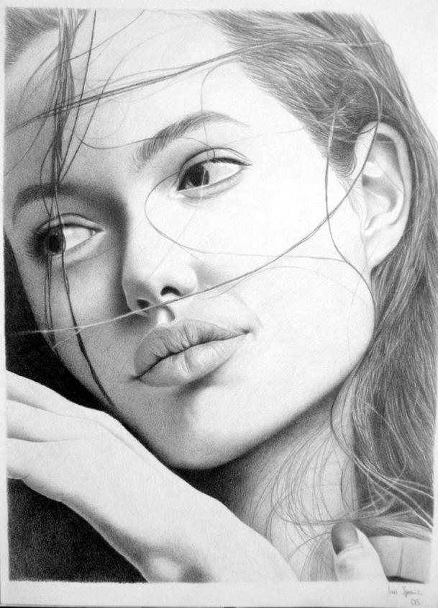
ANGELINA JOLIE
LIZ TAYLOR

Slide 7
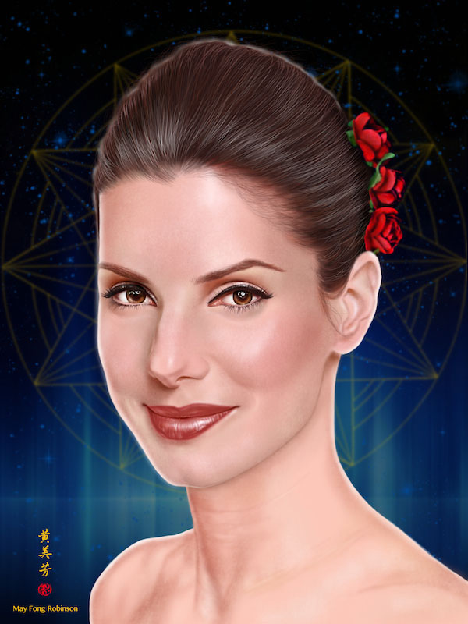
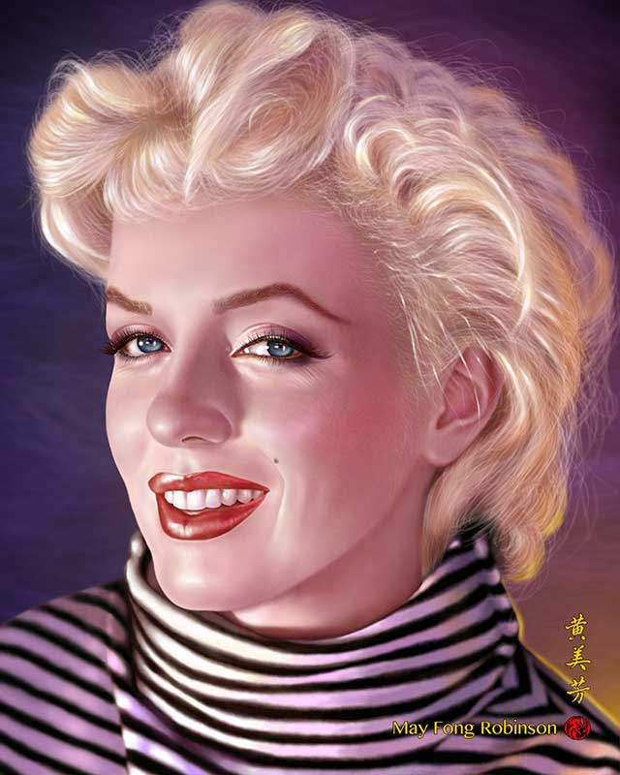
MARILIN MONROE
SANDRA BULLOCK

Slide 8
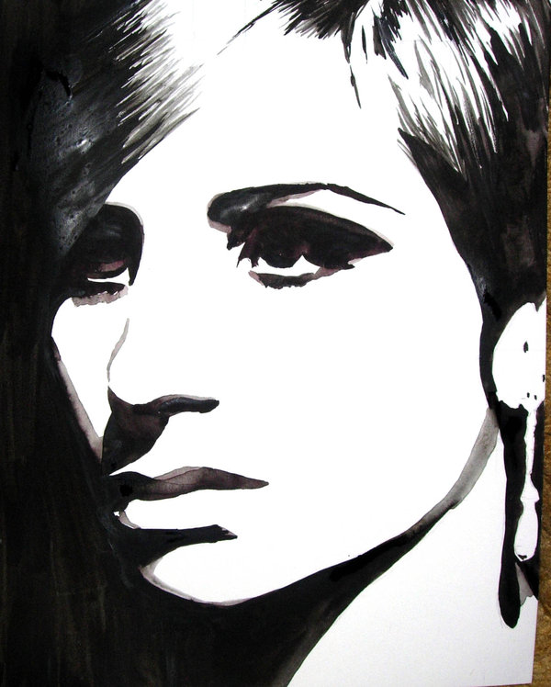
BARBRA STREISAND

Slide 9
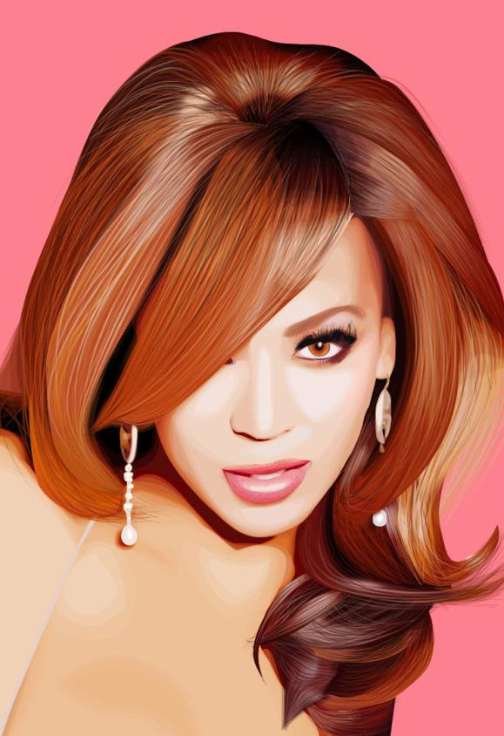
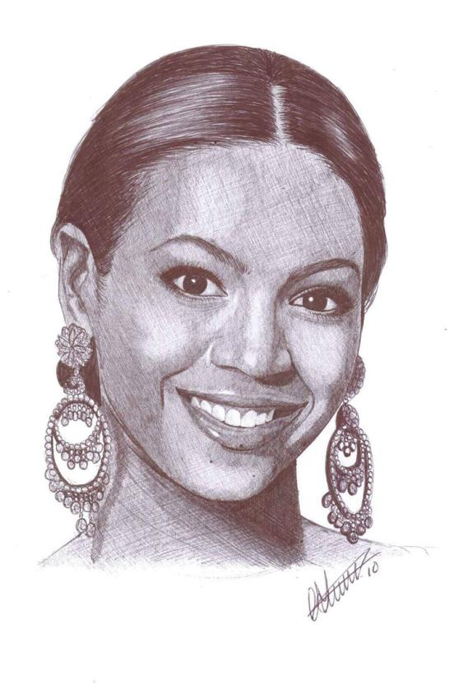
BEYONCE

Slide 10
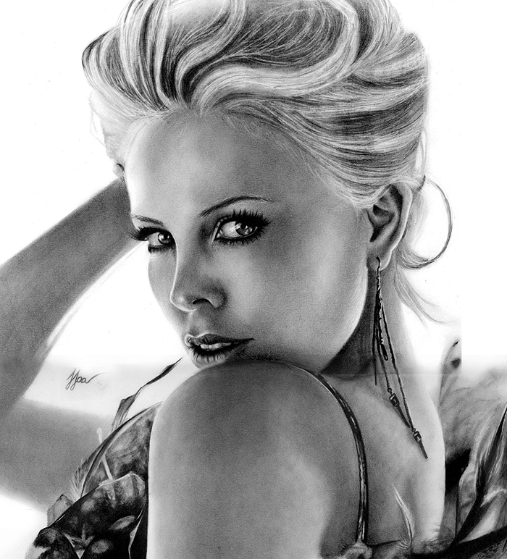
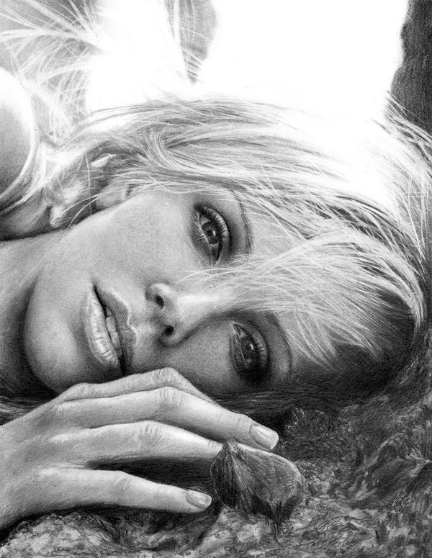
CHARLIZE THERON

Slide 11
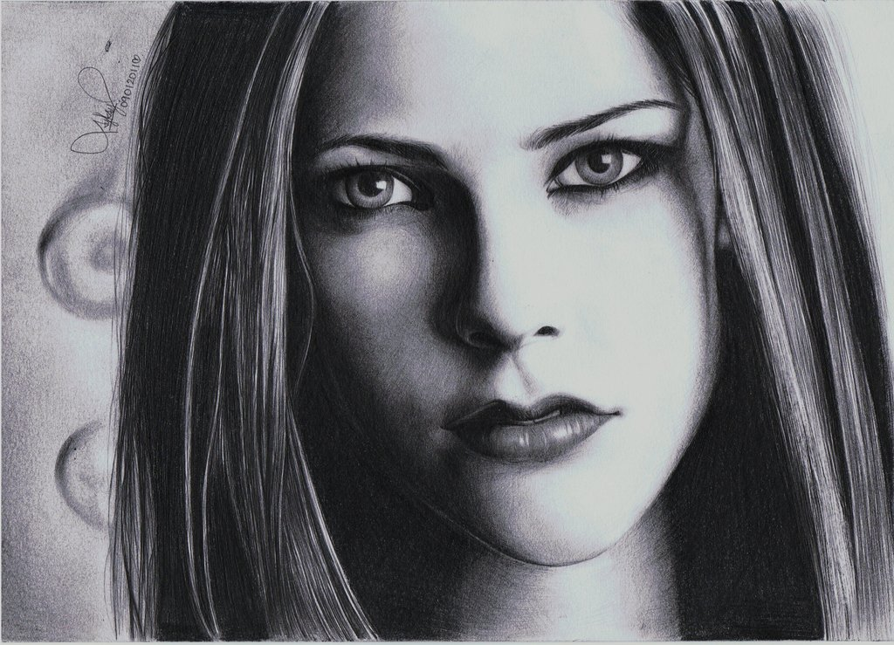
APRIL LAVIGNE

Slide 12
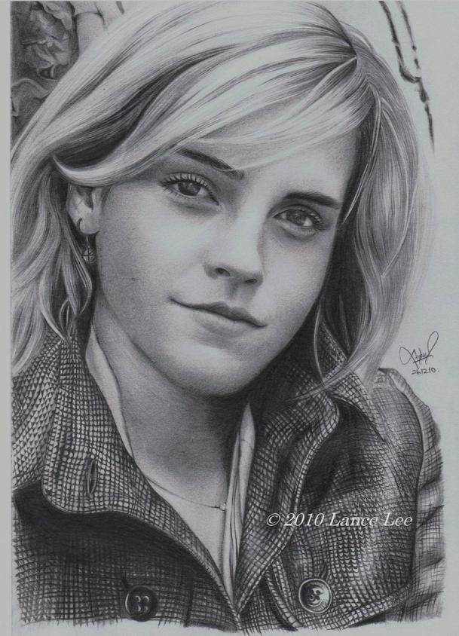
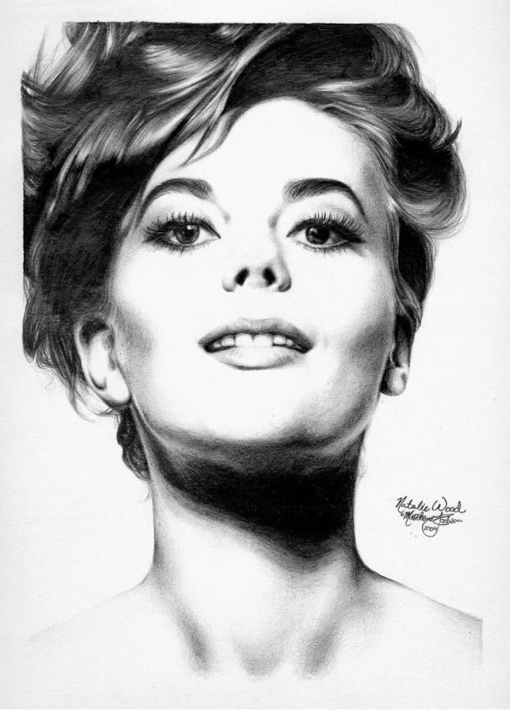
EMMA WATSON
NATALIE WOOD

Slide 13
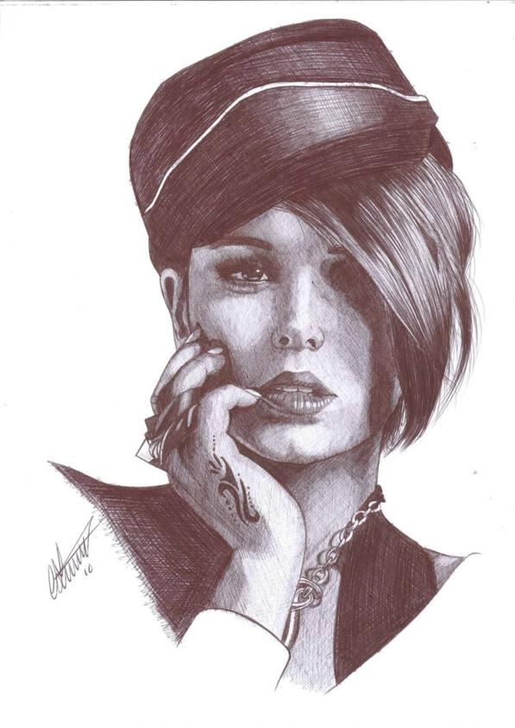
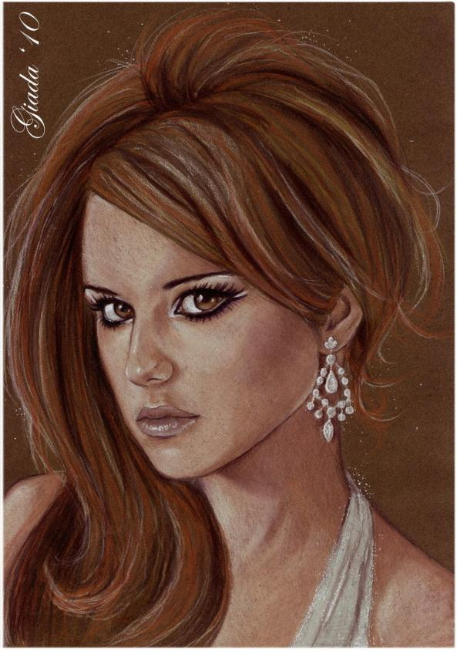
CHERIL COLE

Slide 14
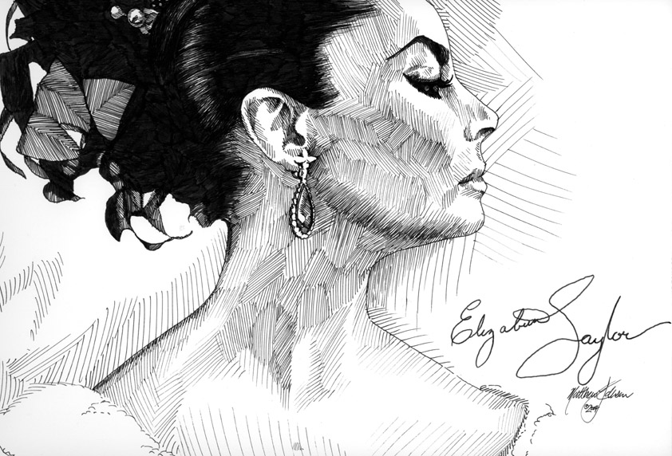
ELIZABETH
TAYLOR

Slide 15
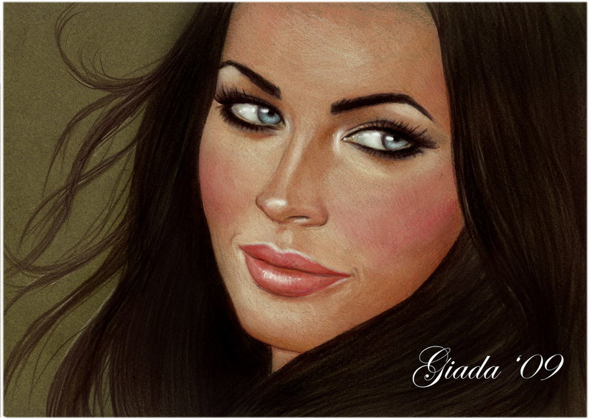
MEGAN FOX

Slide 16
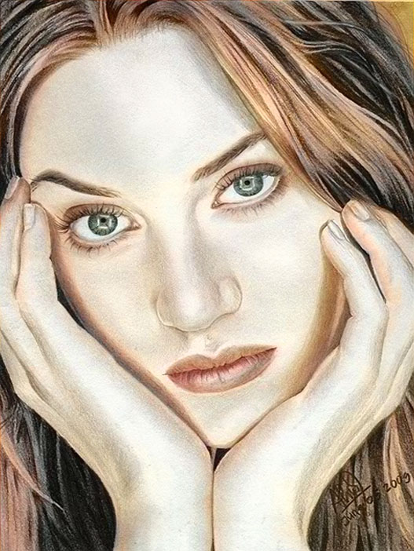
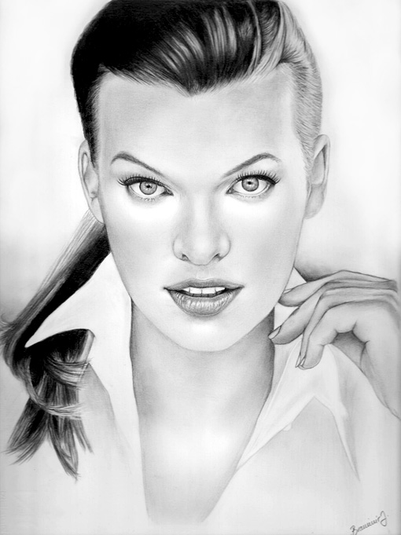
KATE WINSLET
MILLA JOVOVICH

Slide 17
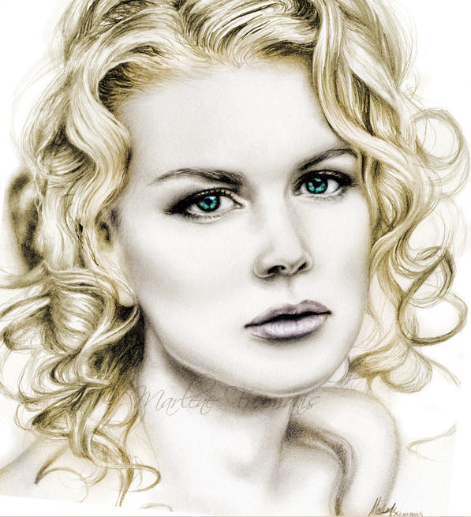
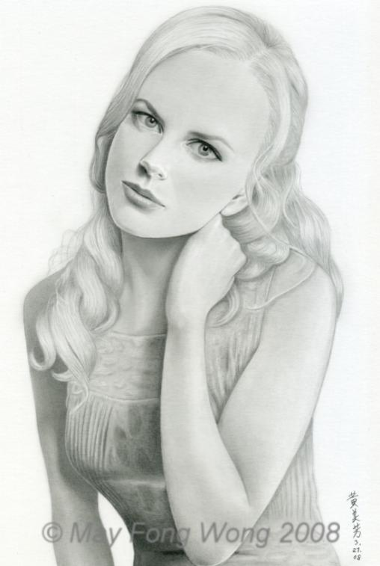
NICOLE KIDMAN

Slide 18
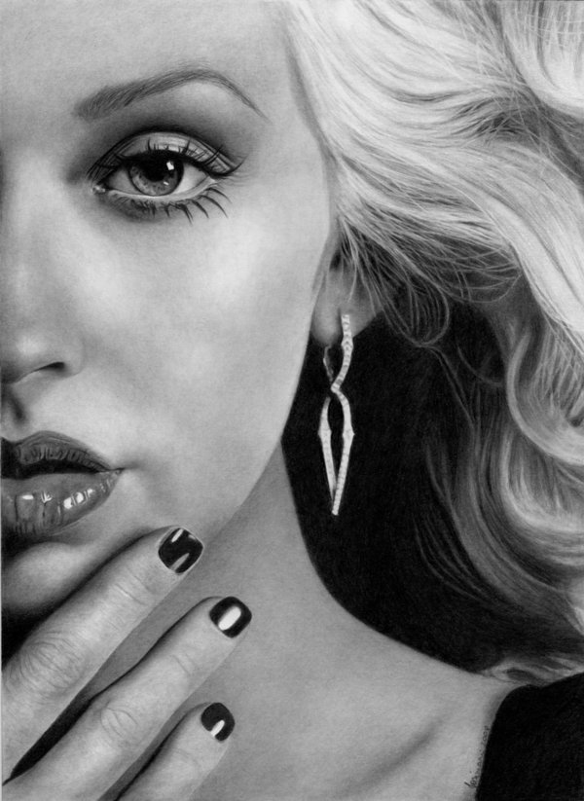
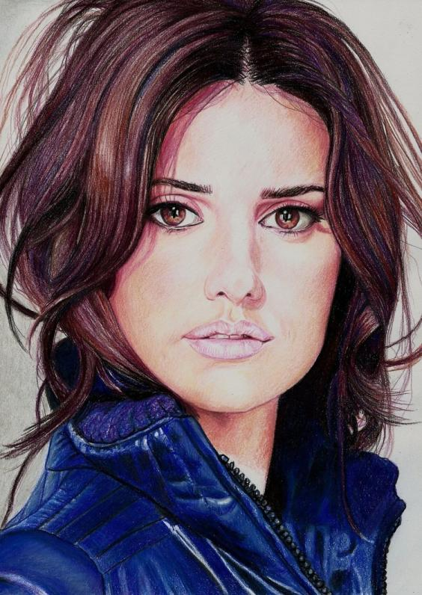
PENÉLOPE CRUZ
CHRISTINA AGUILERA

Slide 19
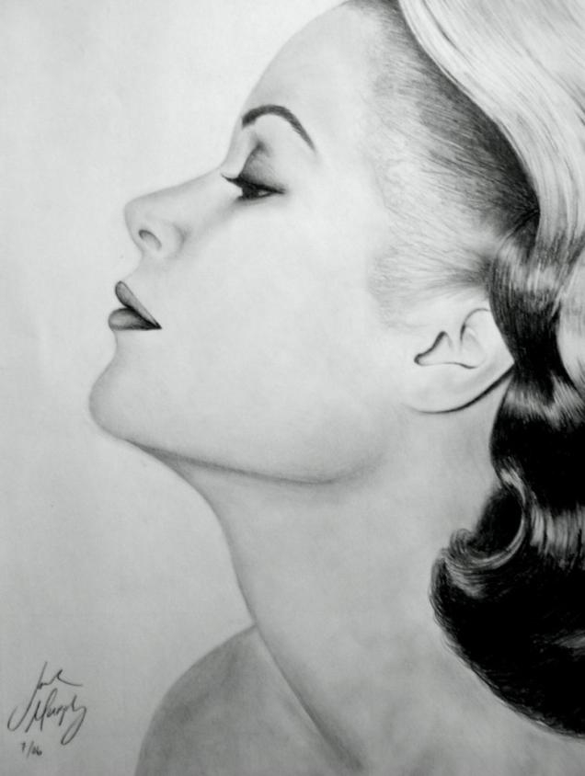
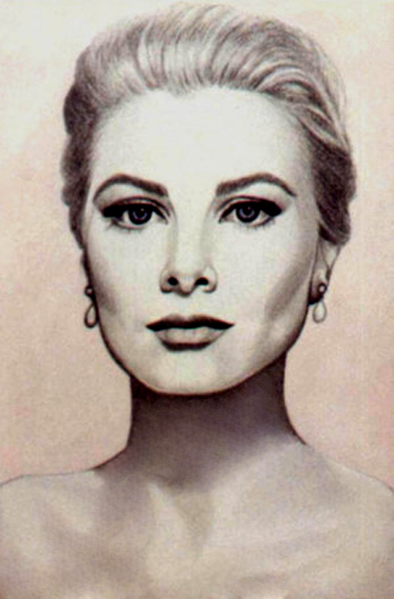
GRACE KELLY

Slide 20
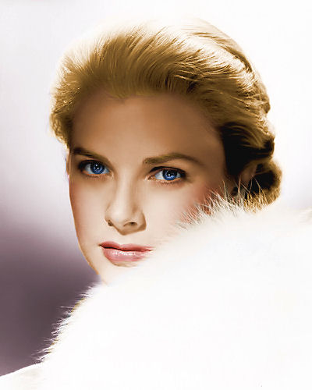
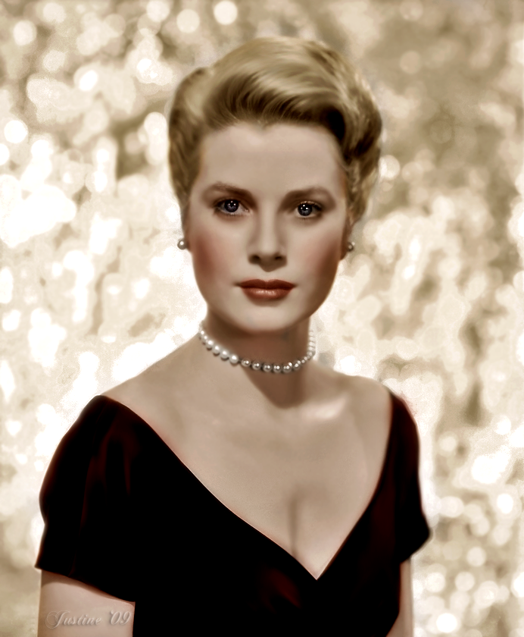
GRACE KELLY

Slide 21
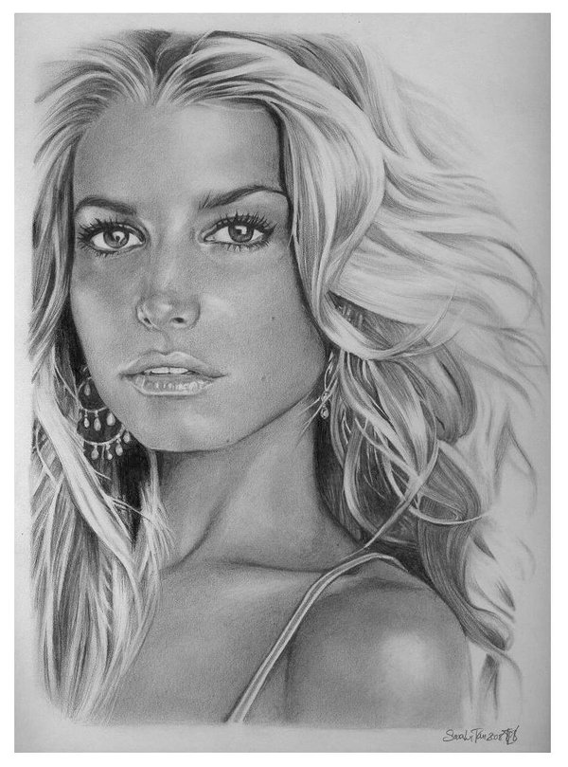
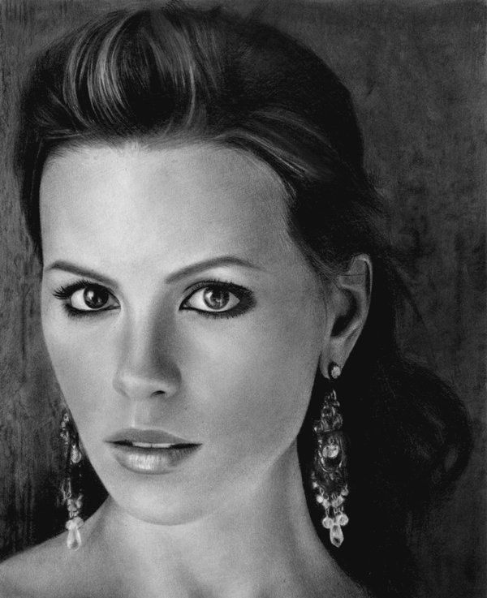
JESSICA SIMPSON
KATE BECKINSALE

Slide 22
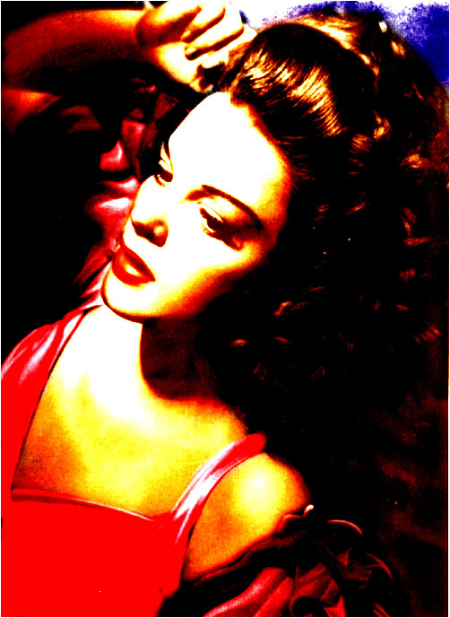
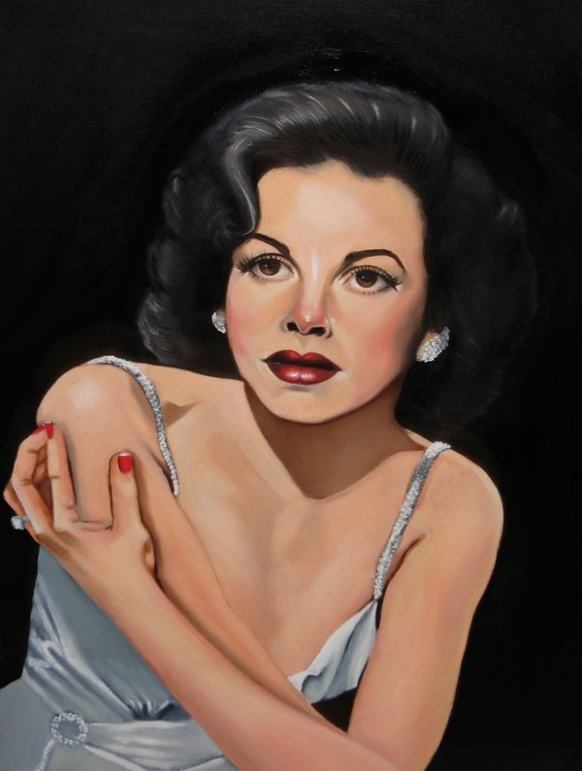
JUDY GARLAND

Slide 23
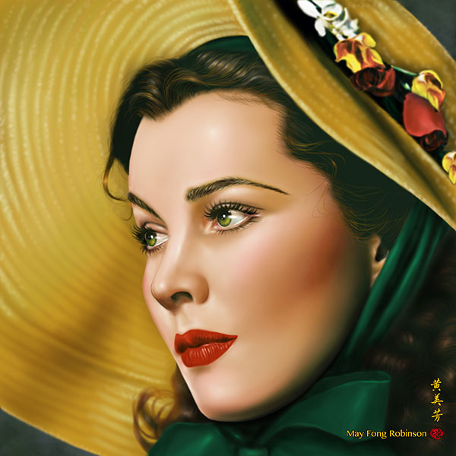
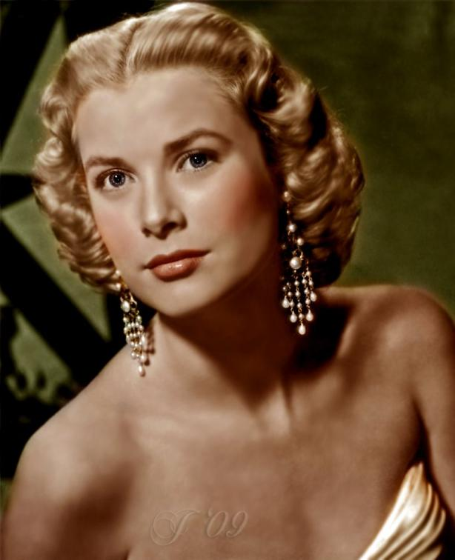
SCARLETT O’HARA
GRACE KELLY

Slide 24
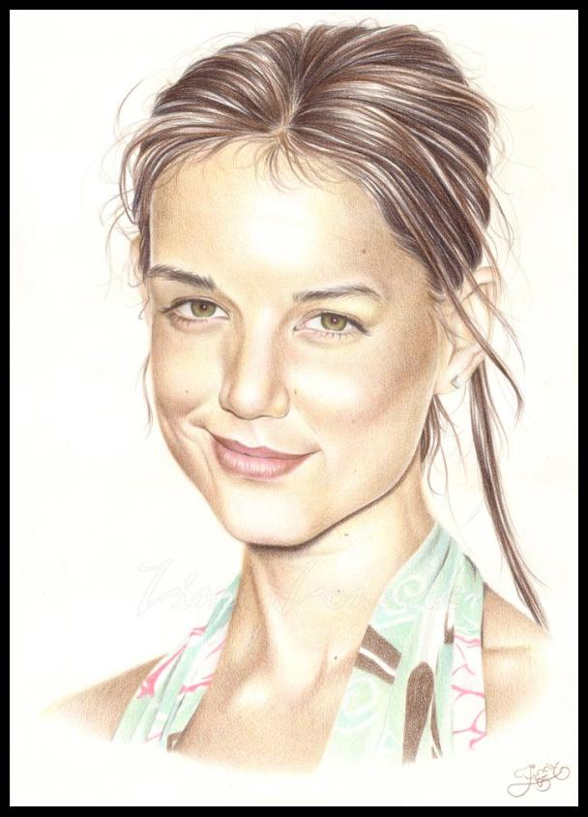
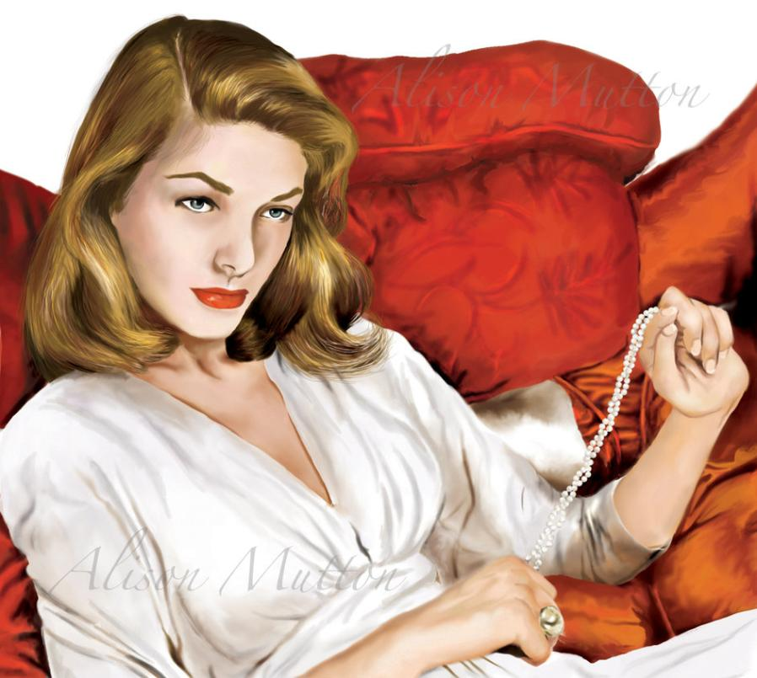
LAUREN BACALL
KATIE HOLMES

Slide 25
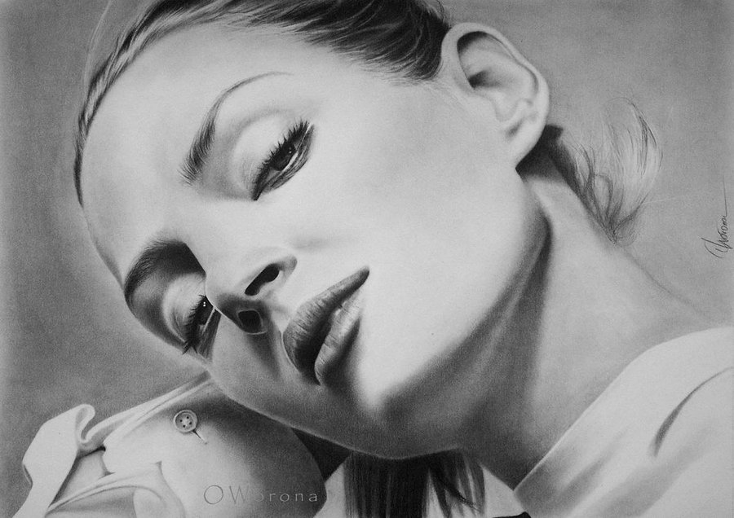
UMA THURMAN

Slide 26
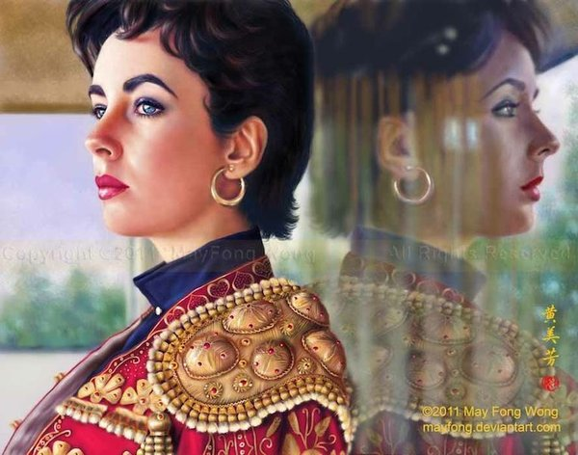
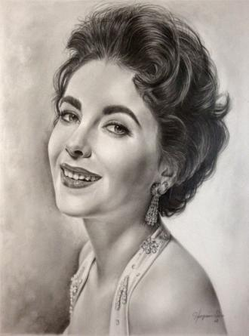
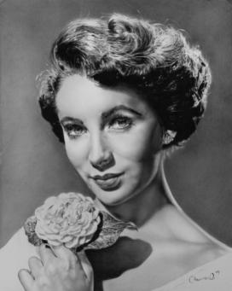
ELIZABETH TAYLOR

Slide 27
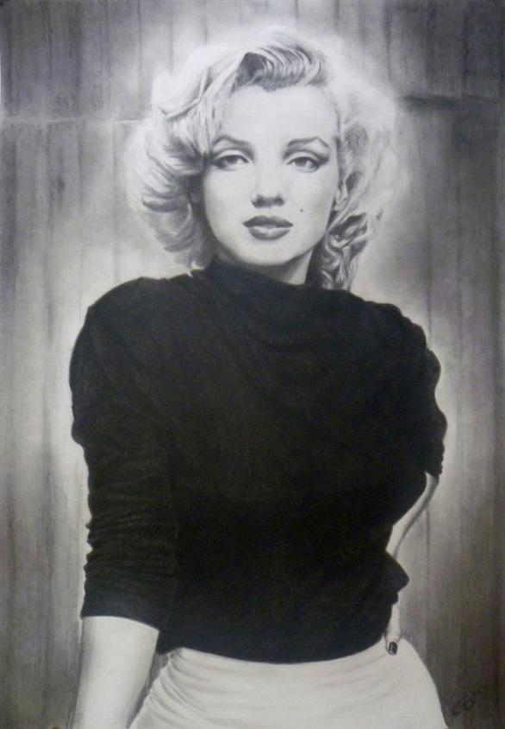
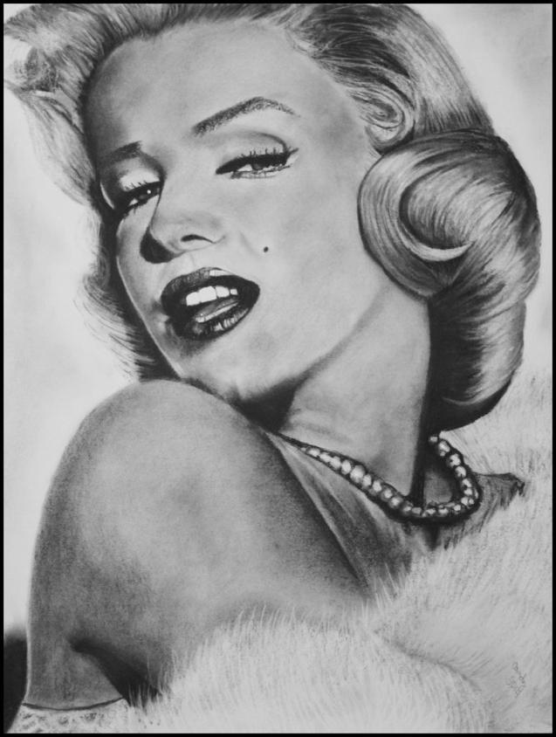
MARILYN MONROE

Slide 28


PRINCESA DIANE

Slide 29


PRINCESA DIANE
CAMERON DIAZ

Slide 30


JACQUELINE KENNEDY

Slide 31

CARA DELEVINGNE

Slide 32

FORMATAÇÃO: MARIA OLÍVIA
macremonini@gmail.com
FOTOS DA INTERNET
NATALIE PORTMAN

