Slide 1
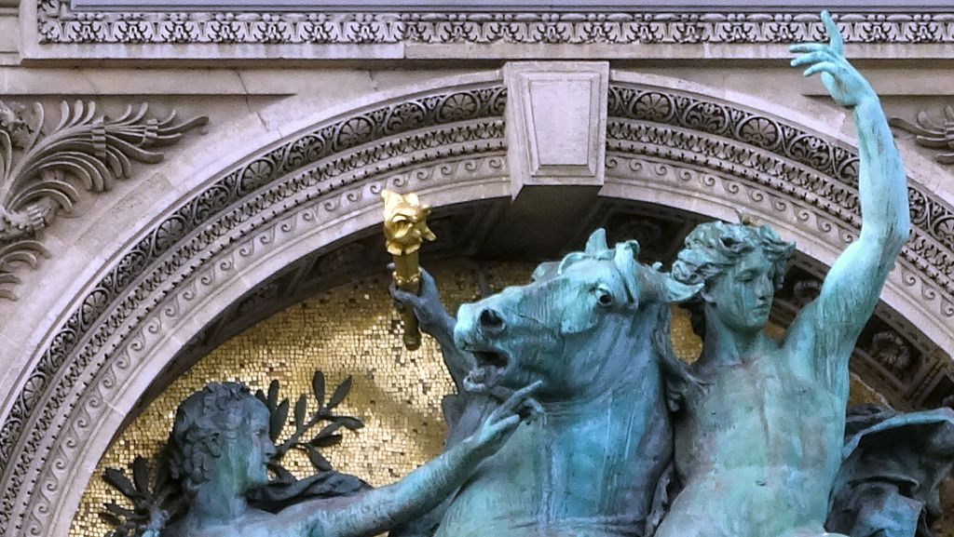
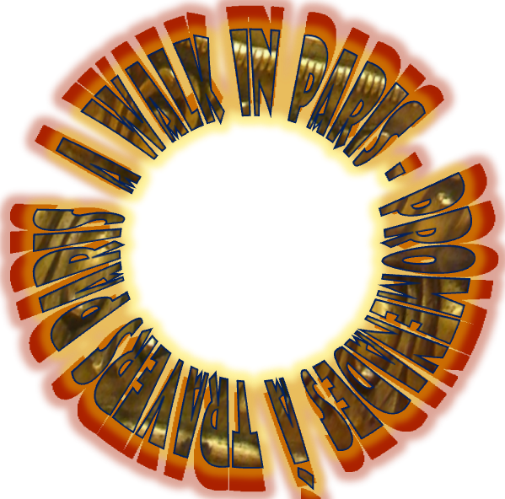



Notes:
Poetry by Charles-Alphonse-Achille Gumery

Slide 2
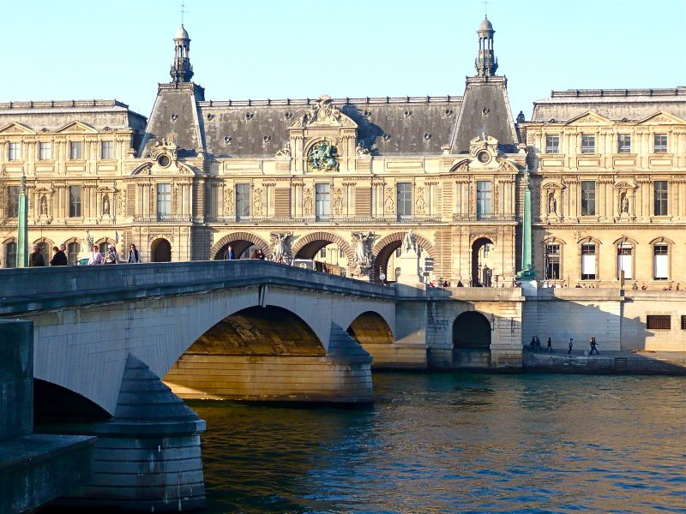
The Louvre and the Pont du Carrousel which spans the River Seine between the Quai des Tuileries and the Quai Voltaire.
The Carrousel bridge, 168 meters long and 33 meters wide, was rebuilt from 1939 to 1943 because it was to low for boats to pass

Slide 3
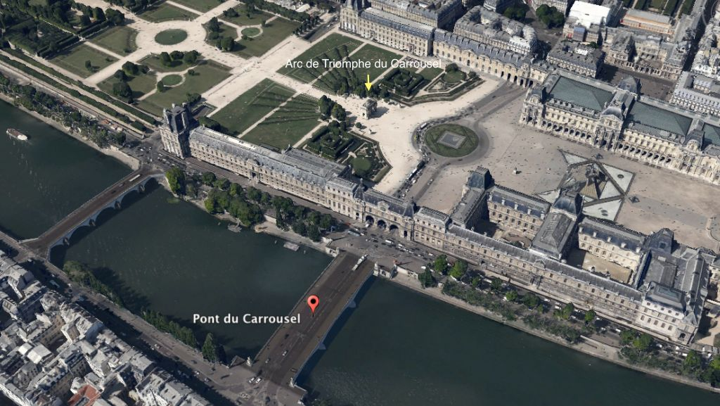

Slide 4
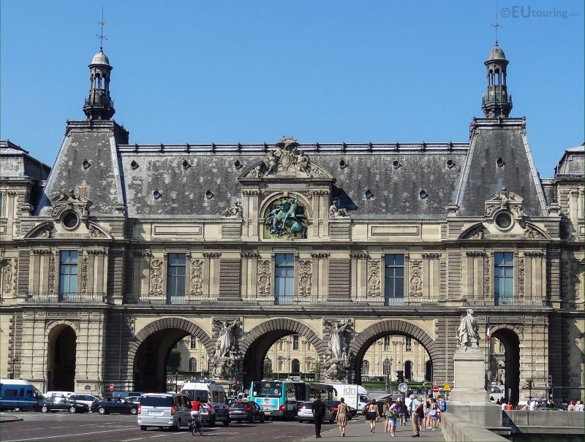
Just by the River Seine there is an entrance to The Louvre Museum and the courtyard where you can access the Arc de Triomphe du Carrousel and the Tuileries Gardens

Slide 5
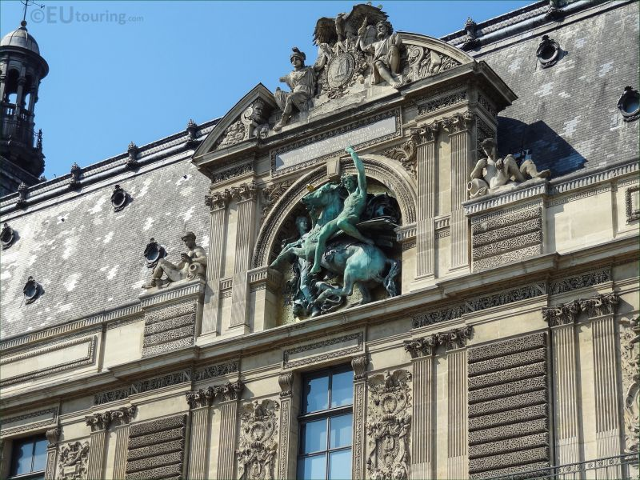
There is an entrance to The Louvre Museum
A statue group called Genius of the Art above the archways at this entrance that also has a placque above stating Napoleon III Empereur

Slide 6
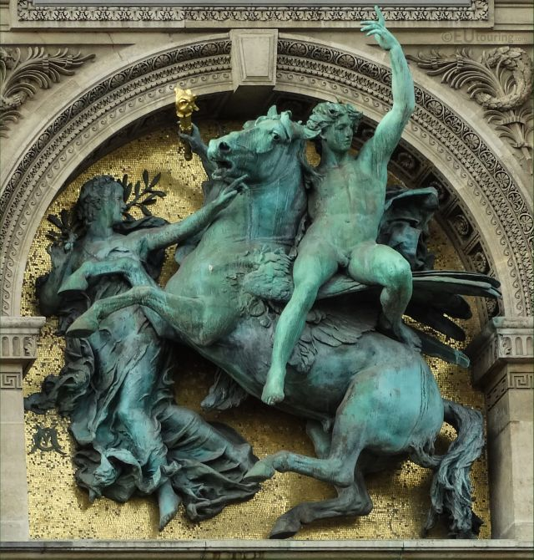
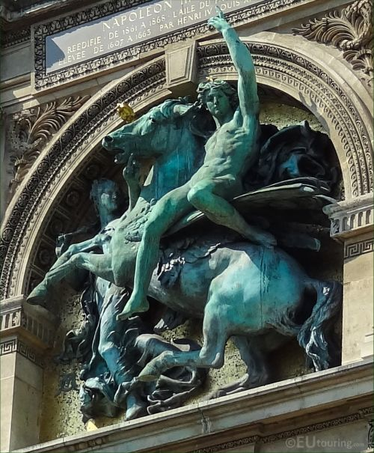
Statue group called Genius of the Art (it is also referred to by the name of Apollo and Pegasus) sculpted by Antonin Mercie

Slide 7
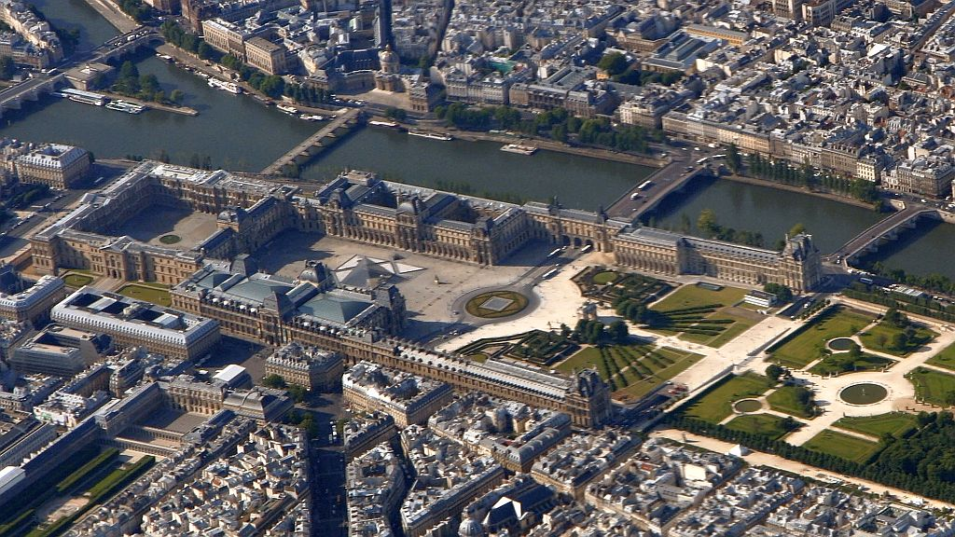
Pont du Carrousel
Arc du Carrousel
Palais-Royal
Jardin des Tuileries

Slide 8
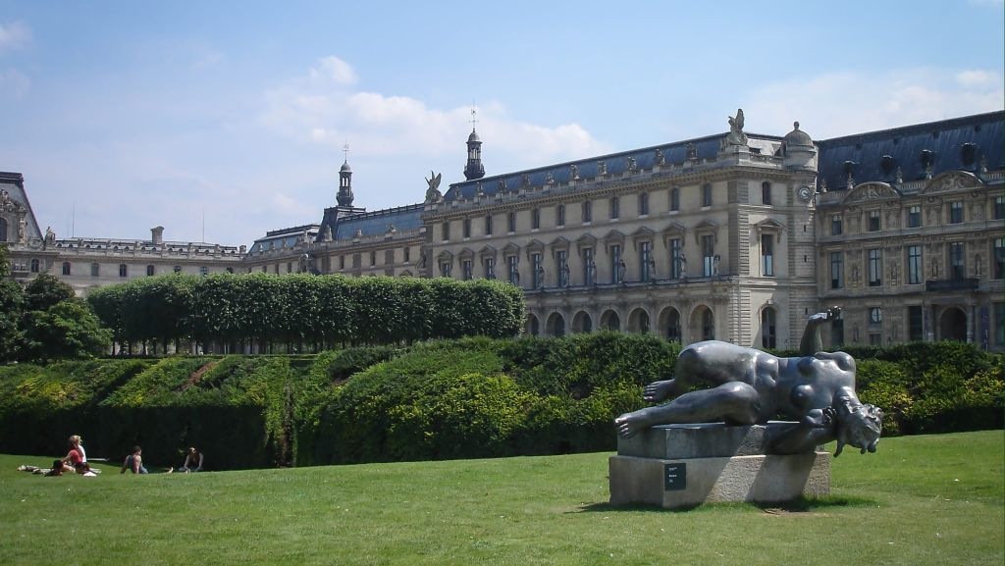
Jardin des Tuileries
La Riviere - statue by Aristide Maillol ©EU touring.com

Slide 9
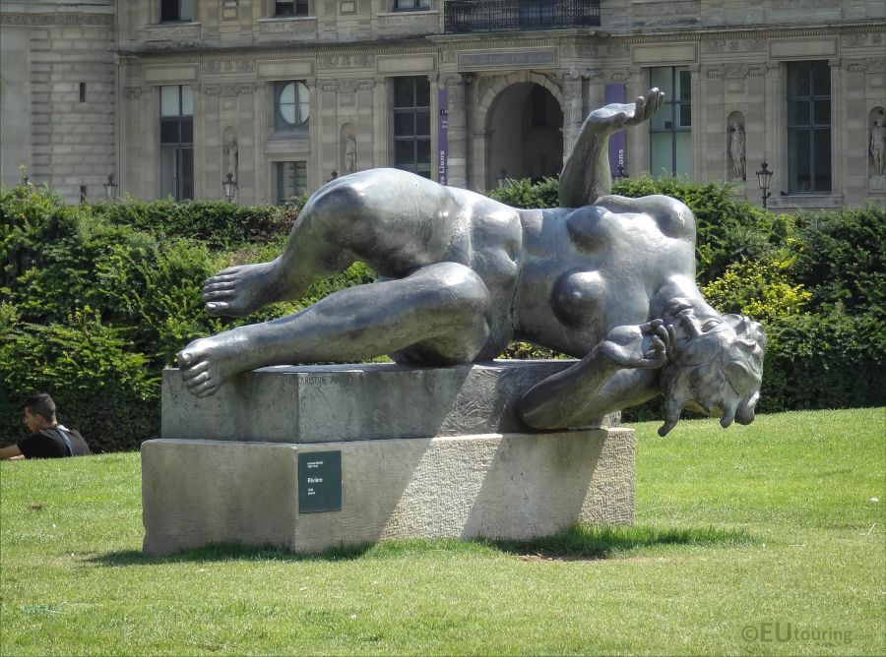
La Riviere
statue by Aristide Maillol
(1861-1944)

Slide 10
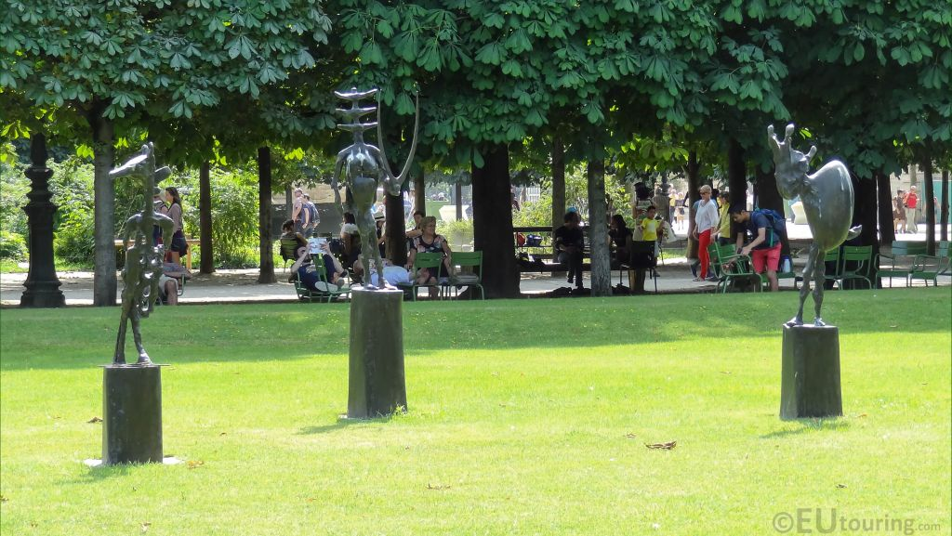
L'échiquier, Grand (1959)
Germaine Richier (1904-1959)

Slide 11
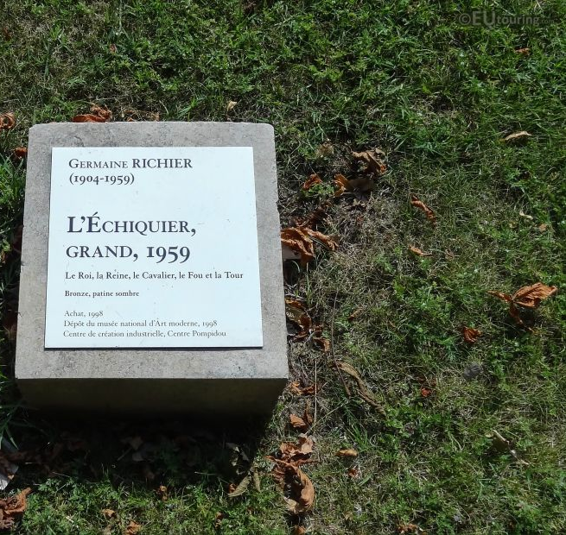
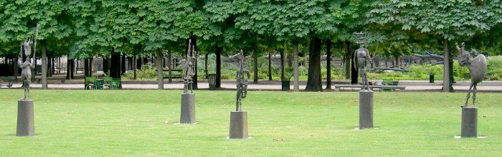
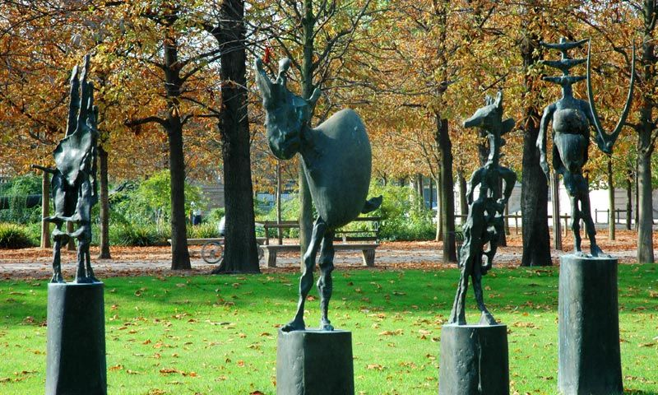

Slide 12
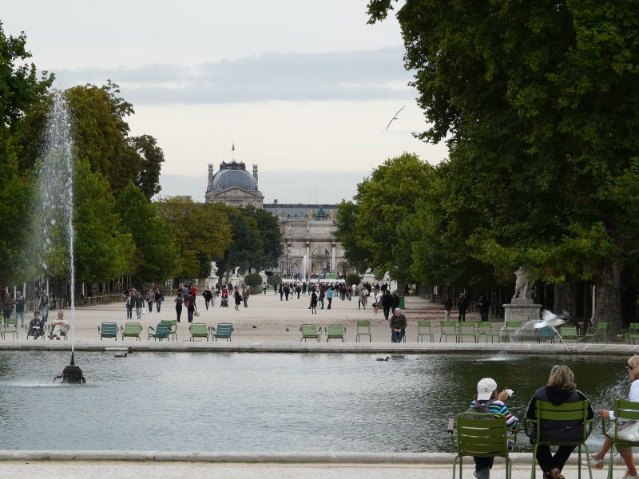
The Tuileries Palace was a royal and imperial palace in Paris which stood on the right bank of the River Seine

Slide 13
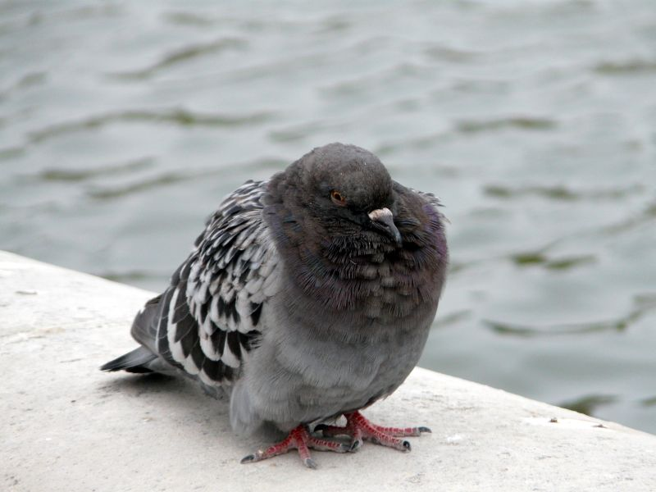
The Tuileries Palace was the usual Parisian resi-dence of most French monarchs, from Henry IV to Napoleon III, until it was burned by the Paris Commune in 1871

Slide 14
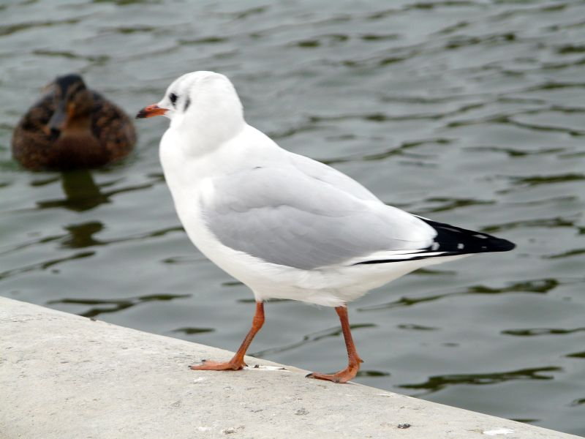
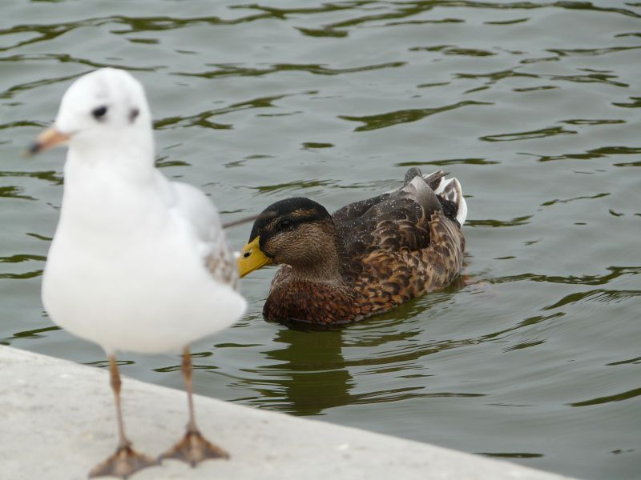
Jardin des Tuileries as the garden of the Tuileries Palace was eventually opened to the public in 1667 and became a public park after the French Revolution. In the 19th and 20th centuries, it was a place where Parisians celebrated, met, strolled, and relaxed

Slide 15
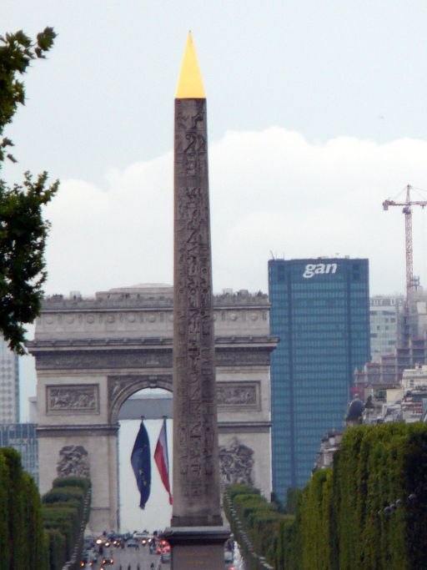
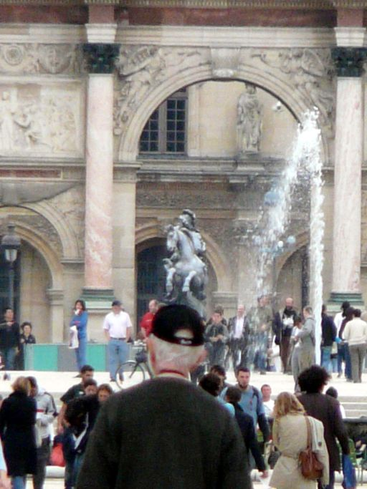
L'obelisk du Place de la Concorde and Arc de l'Etoile
Arc de Triomphe du Carrousel

Slide 16
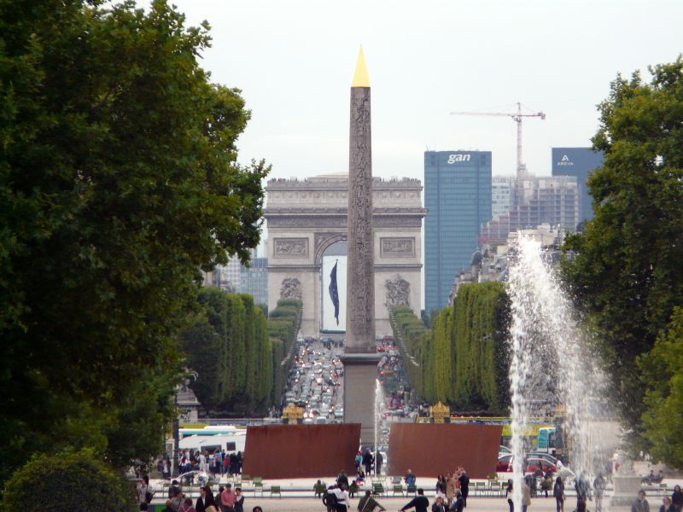
The Luxor Obelisk standing at the centre of the Place de la Concorde and Arc de l'Etoile seen from the Tuileries

Slide 17
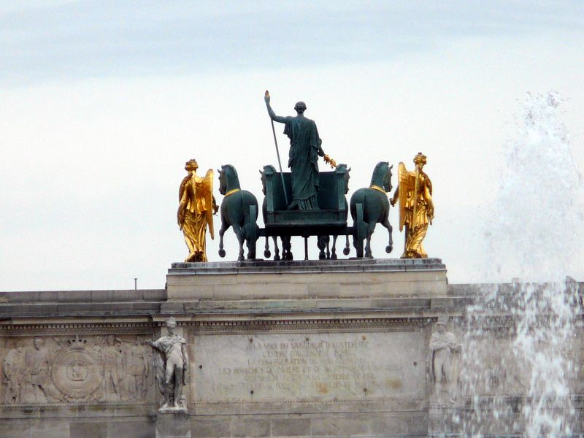
The quadriga that are on top of the Arc de Triomphe du Carrousel, which are often referred to as the Horses of Saint Mark, or Horses of San Marco (this bronze statue group are a copy of the originals, which were produced by the artist Baron Francois Joseph Bosio in 1828 commemorating the Restoration)

Slide 18
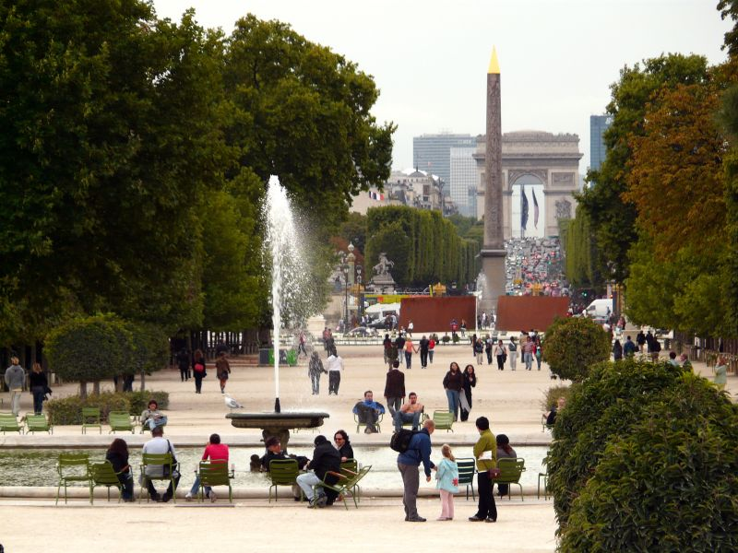
The Grand Bassin Rond, which is located along the Central Alley of the Tuileries Gardens is a popular place to relax on the free to use green chairs that are laid out

Slide 19
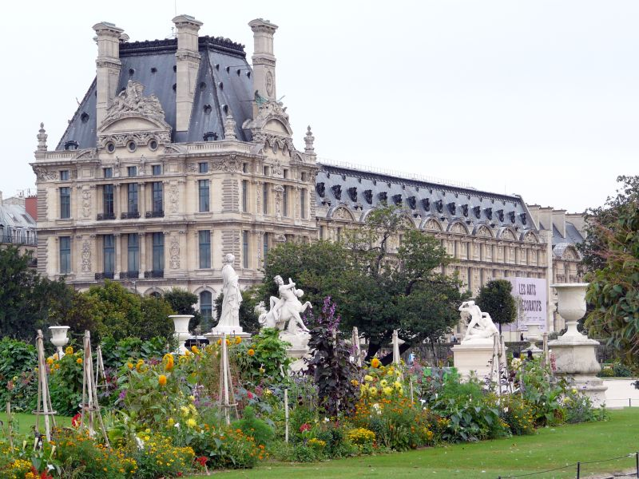
Pavillon de Marsan North wing

Slide 20
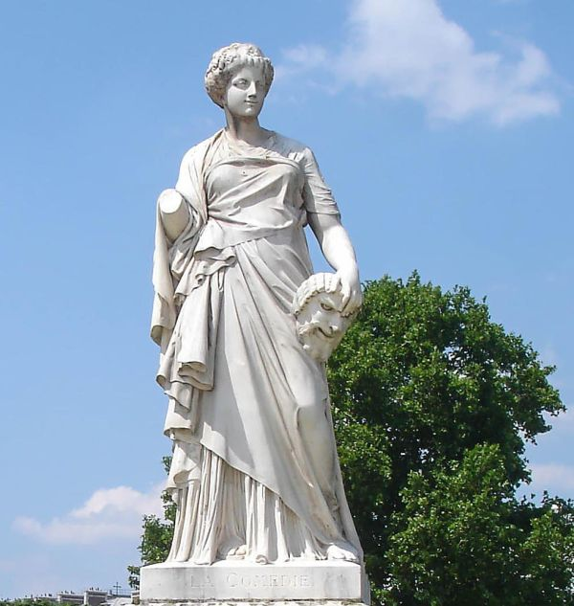
The statue La Comedie
by Julien Toussaint Roux
1874

Slide 21
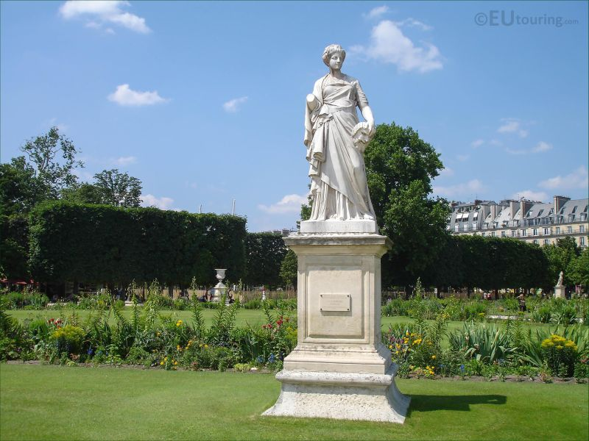
La Comedie
by Julien Toussaint Roux
1874

Slide 22
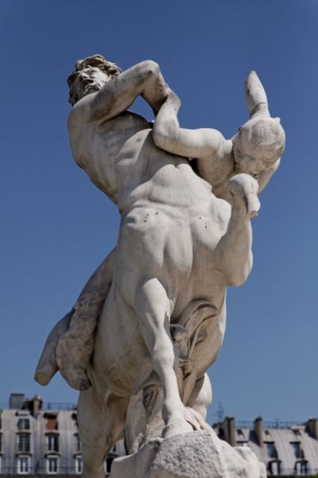
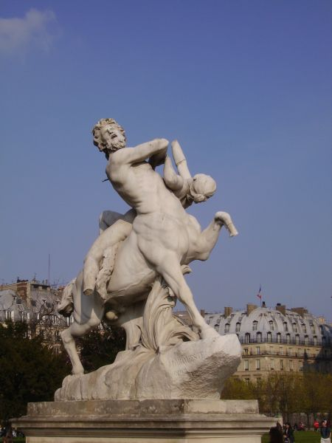
Tuileries Gardens
Le centaur Nessus enlevant Dejanire

Slide 23
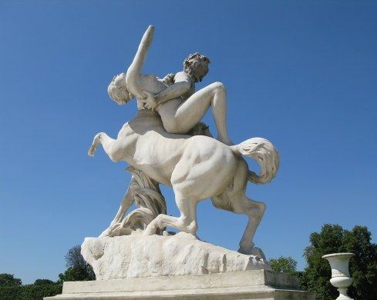
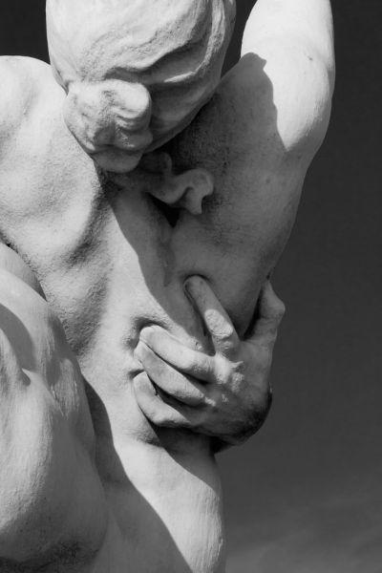
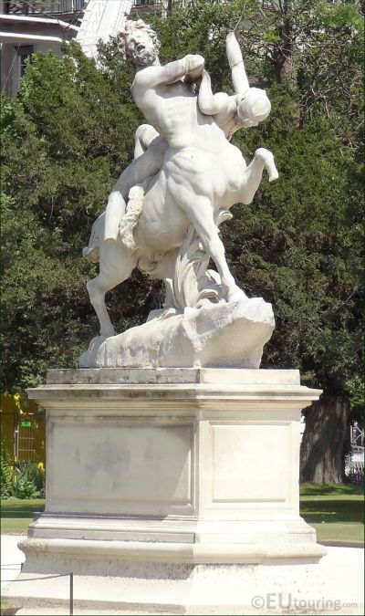
Le centaur Nessus enlevant Dejanire

Slide 24
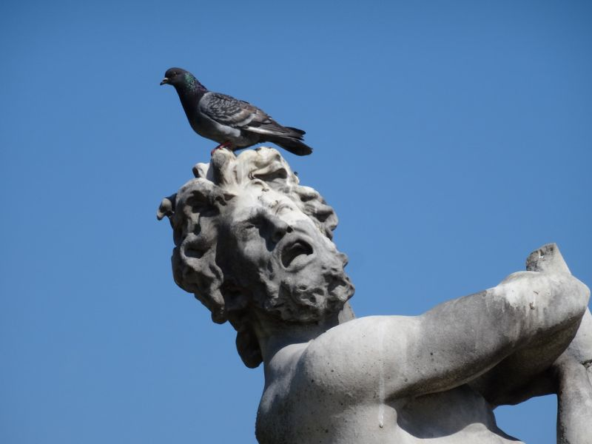
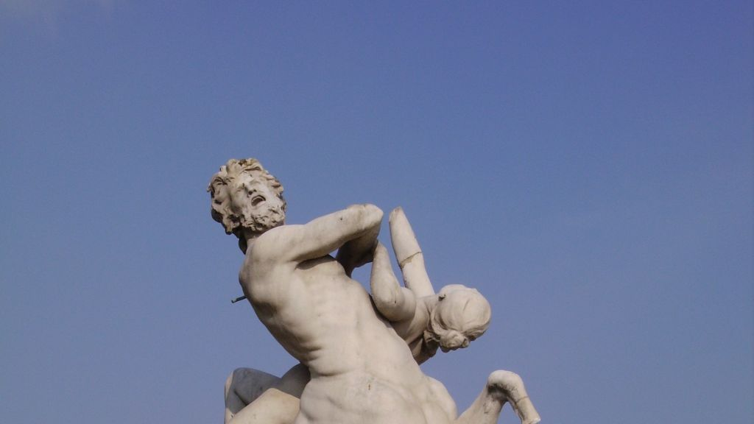

Slide 25
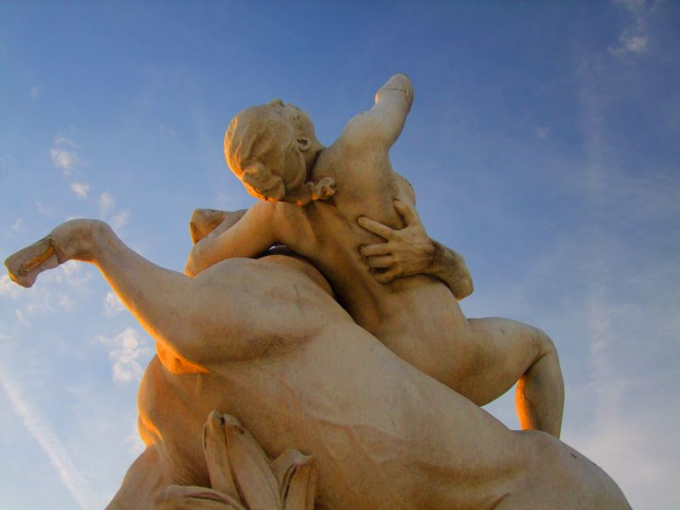
Laurent Honoré Marqueste
Le centaur Nessus enlevant Dejanire

Slide 26
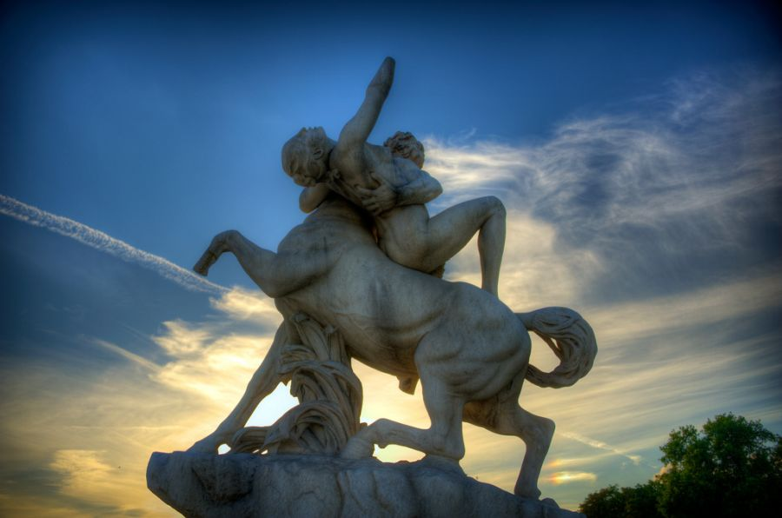

Slide 27
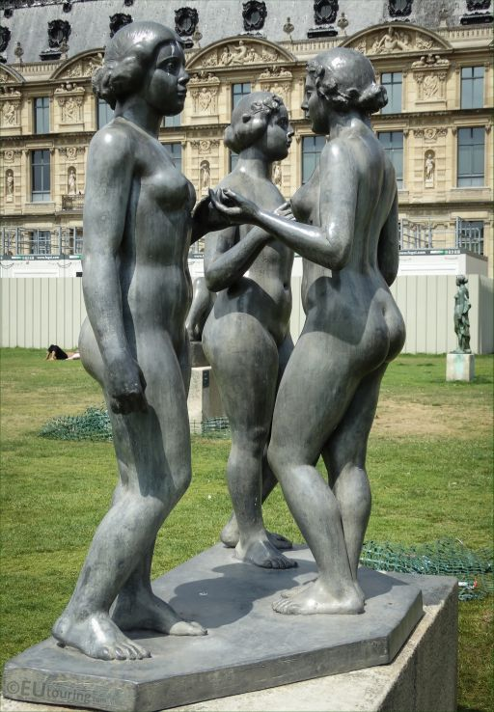
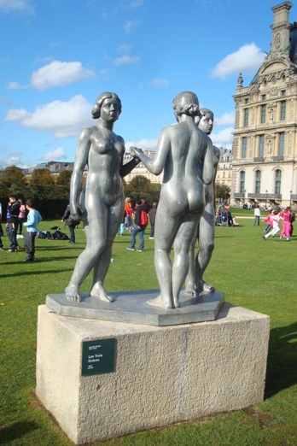
Les trois graces by Aristide Maillol
(1861-1944)

Slide 28
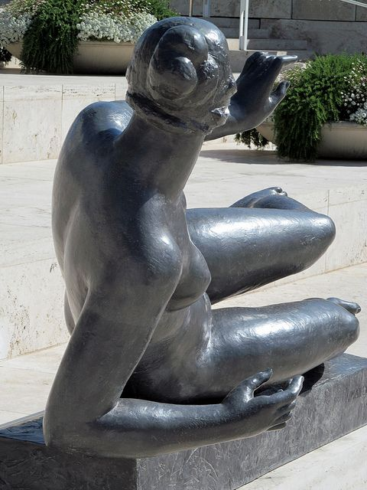
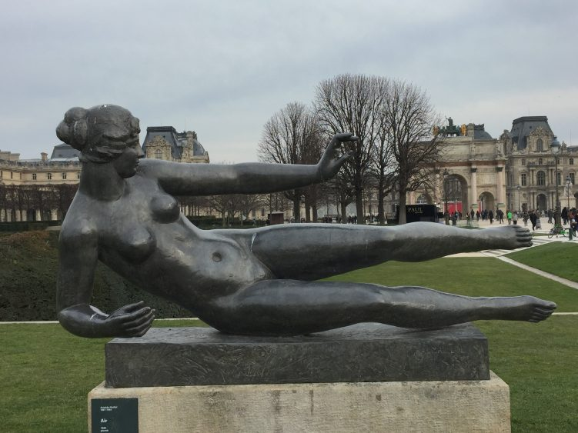
Air
by Aristide Maillol
(1861-1944)

Slide 29
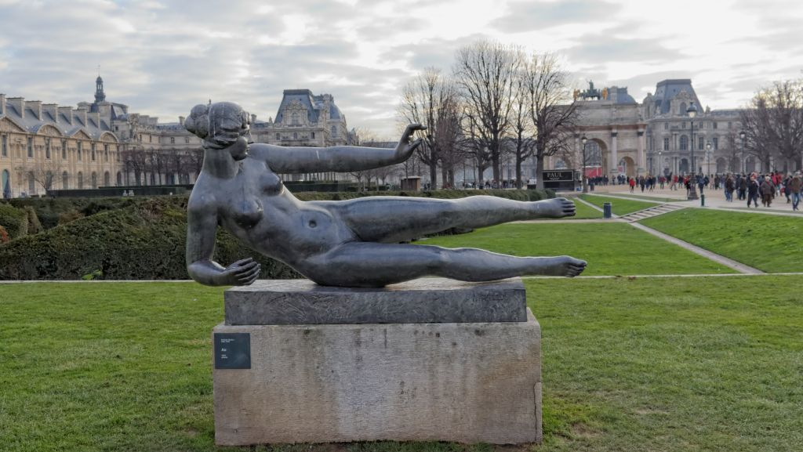
Air
by Aristide Maillol
(1861-1944)

Slide 30
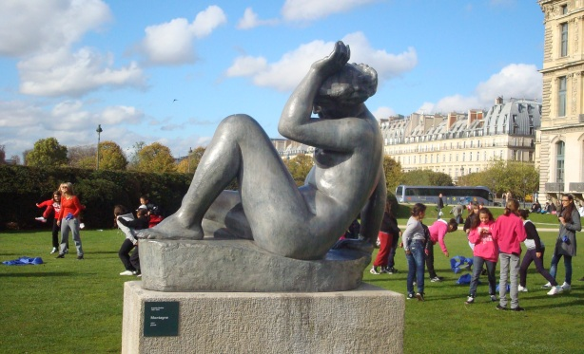
La Montagne
by Aristide Maillol
(1861-1944)

Slide 31
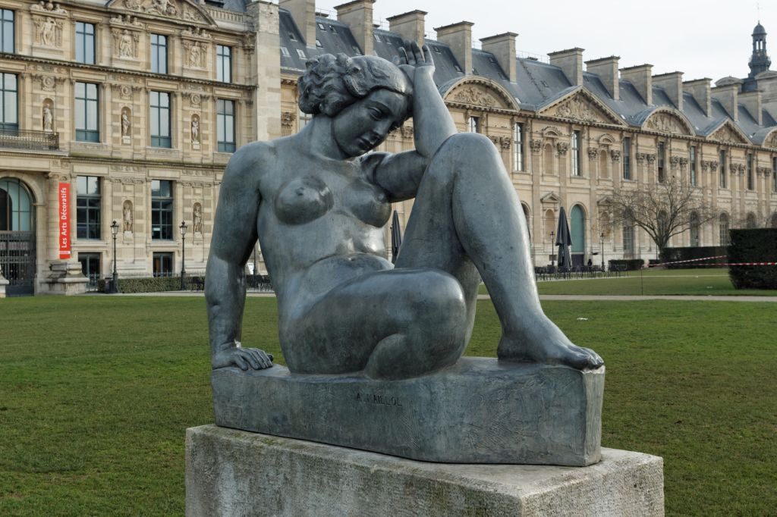
La Montagne
by Aristide Maillol
(1861-1944)

Slide 32
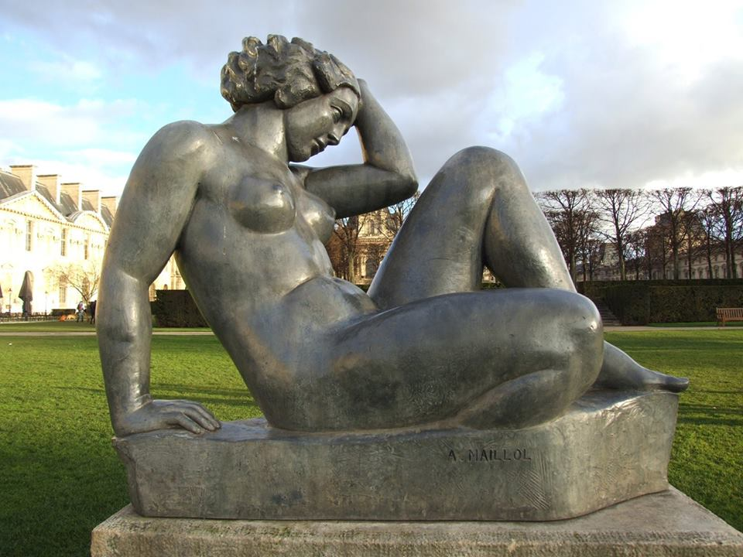
La Montagne
by Aristide Maillol
(1861-1944)

Slide 33
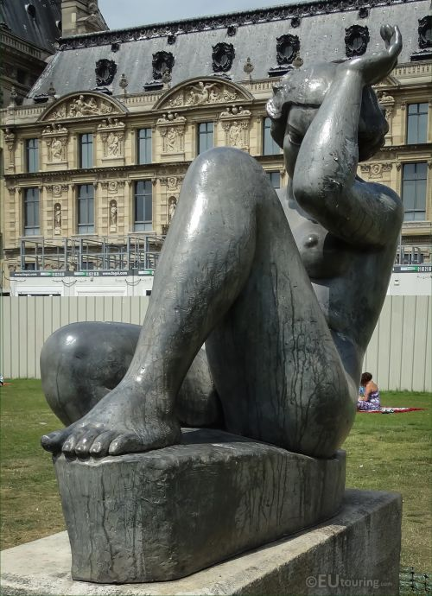
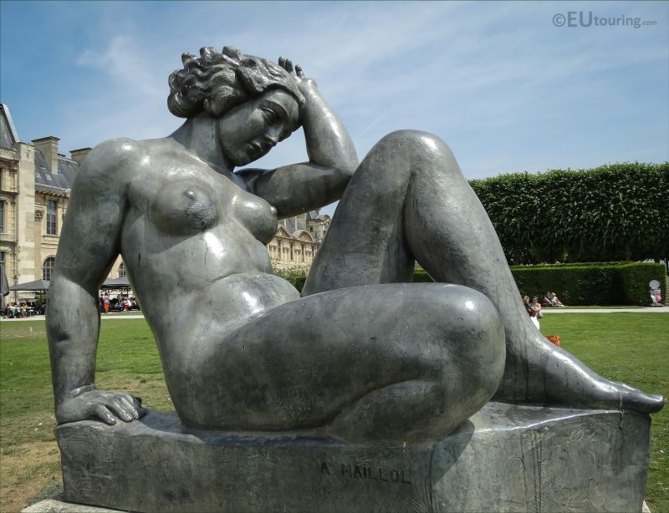
La Montagne
by Aristide Maillol
(1861-1944)

Slide 34
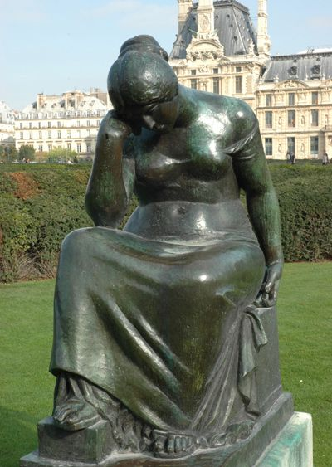
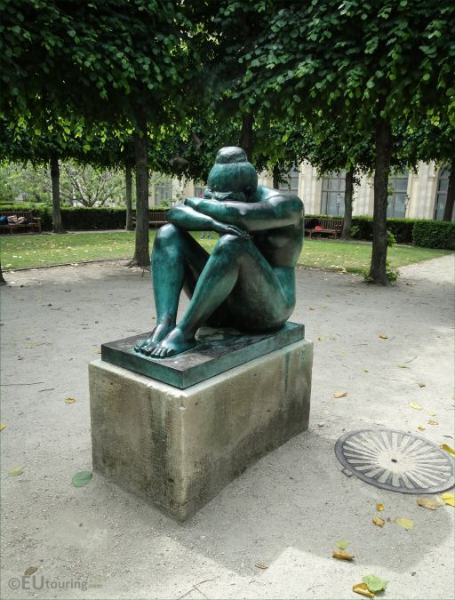
Douleur 1912 Aristide Maillol
La nuit
by Aristide Maillol
(1861-1944)

Slide 35
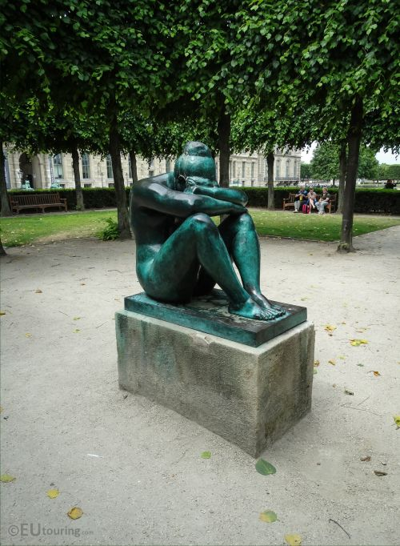
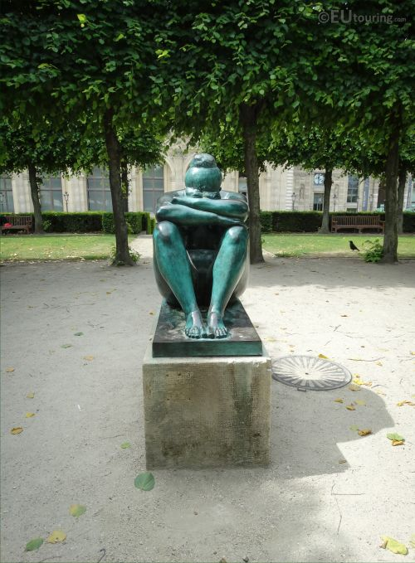

La nuit
by Aristide Maillol
(1861-1944)

Slide 36

"Cain venant de tuer son frere Abel" or "Cain coming from having killed his brother Abel”
1896
Henri Vidal (1864-1918) ©Marian Lemke

Slide 37



Cain venant de tuer son frere Abel
1896
Henri Vidal

Slide 38


Cain venant de tuer son frere Abel
1896
Henri Vidal

Slide 39

Médée (1896)
Paul-Jean-Baptiste Gasq (1860-1944)

Slide 40


L'Homme et sa misère ou La misère
Jean-Baptiste Hugues (1840-1930)

Slide 41


Slide 42

Diane (1866)
Louis Auguste Lévêque (1814-1875)

Slide 43

Louvre
The Pavillon Sully and the pyramid designed by Chinese-American architect I.M. Pei

Slide 44


Monument à Paul Cézanne
by Aristide Maillol (1861-1944)

Slide 45



Slide 46




Slide 47

Monument à Paul Cézanne
by Aristide Maillol (1861-1944)

Slide 48


Slide 49

Église Saint-Germain-l'Auxerrois
situated at 2 Place du Louvre

Slide 50


Église Saint-Germain-l'Auxerrois
Founded in the 7th century, the church was rebuilt many times over several centuries
The north tower was added in 1860

Slide 51


This window display is really lovely
Paris

Slide 52

Floating restaurant «O Fil de L'O» on the River Seine by Quai de Montebello, beside Pont de l'Archeveche

Slide 53



Text: Internet
Pictures: Internet & Adrian Moacă
All copyrights belong to their respective owners
Presentation: Sanda Foişoreanu
https://plus.google.com/+SandaMichaela
2018
Sound: Mireille Mathieu - Paris en colère; Johnny Hallyday - J'ai oublié de vivre
Notes:
Paris fotos 2008 Ady Moaca + Internet images

